Slide 1

JAIN SLEE
Dima Ionut Daniel

Slide 2
Contents
What is JAIN SLEE?
Basic Concepts
Resource Adaptor
Activity/ActivityContext
Events
Services
SBB
Deployable Unit
Profiles
Usage Parameters
SBB Lifecycle
Facilities
Management
Resource Adaptor
Transactions
SLEE Vendors
Mobicents SLEE
Diameter Base RA
Conclusions
Bibliography

Slide 3

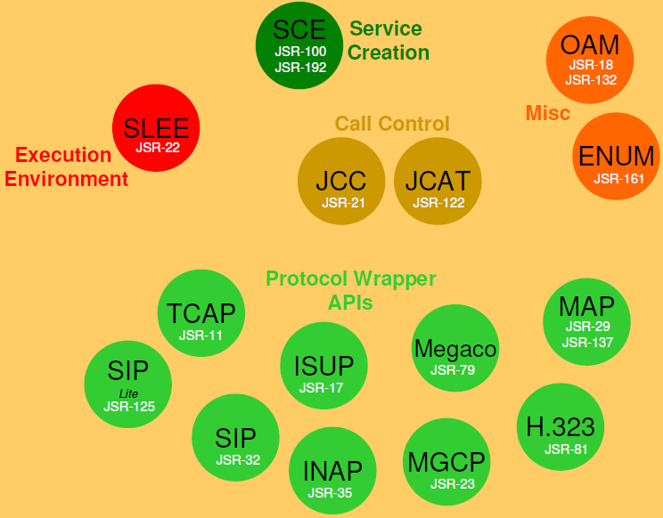
What is JAIN SLEE?
SLEE stands for Service Logic Execution Environment.
JAIN stands for Java APIs for Intelligent Networks
JAIN SLEE is Java based "Write once – Run anywhere".
JAIN SLEE is standardized in Java Community Process:
JAIN SLEE 1.0 --> JSR 22
JAIN SLEE 1.1 --> JSR 240
JAIN is an enabling set of Java APIs to develop and deploy service driven network applications and services.
~2005

Slide 4
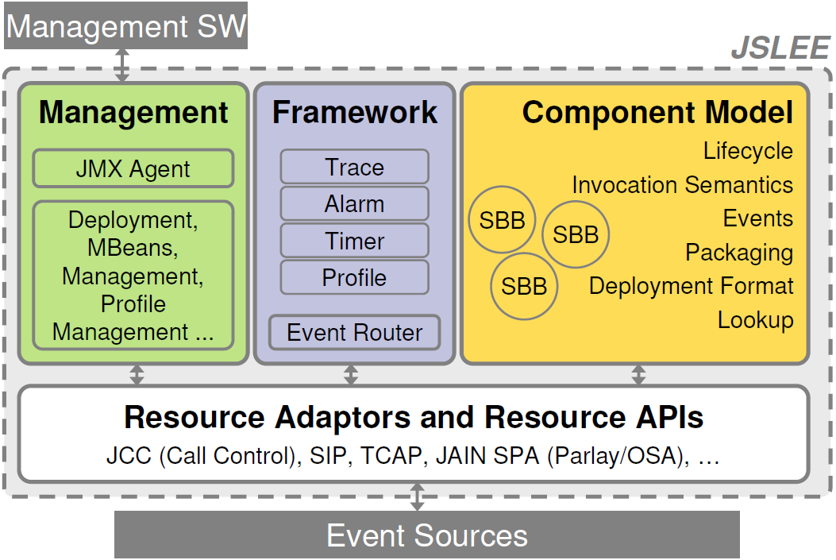
What is JAIN SLEE? (cont.)
JSLEE - low latency and high throughput application server for event processing

Slide 5
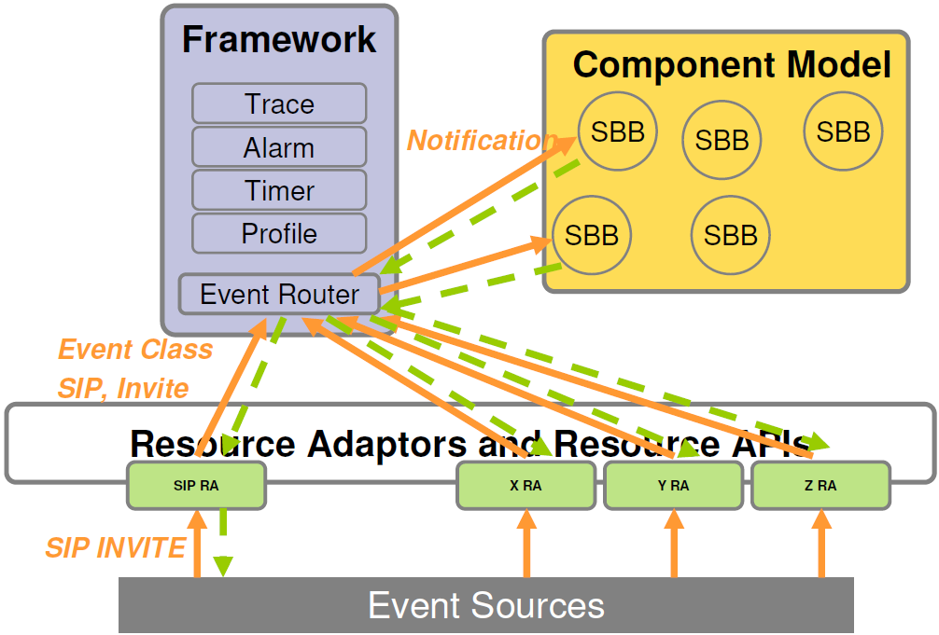
Basic Concepts
Every component type is a Deployable Unit (DU)
Concurrency control is implemented by the environment, not the application.
JSLEE is event driven and knows producer consumer relationships.

Slide 6
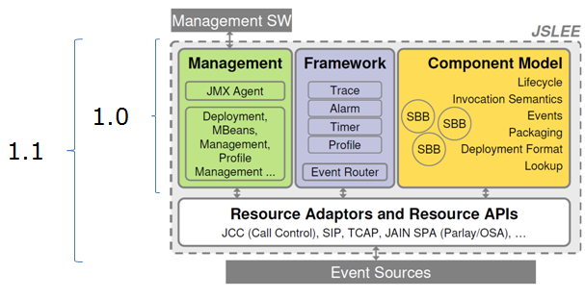
Basic Concepts (cont.)
JSR 22 was finished in 03 Mar 2004.
defines Service ←→Resource API interface
JSR 240 was finished in 14 Jul 2008.
defines Service ←→ Resource Adaptor interface

Slide 7
Basic Concepts
Resource Adaptor

Slide 8
Resource Adaptor
External resources are represented in SLEE by Resource Adaptors(RA)
RA adapts an external resource for use by services in the SLEE
System level component
Incoming flow (external resource -> SLEE): modeled as events
Outgoing flow (SLEE -> external resource): modeled as method invocations on objects provided by the RA
RA submits events via a 'SleeEndpoint'; SLEE routes the events to 0 or more SBBs.
A "plugin" adapts a network protocol to JSLEE event based communication.

Slide 9
Basic Concepts
Activity/ActivityContext

Slide 10
Activity/ActivityContext
An Activity is a Java interface that represents a conversation with another system.
Commonly Activities model Sessions, Dialogs or Protocol Request / Response pairs
Activities are in the resource domain
Events are delivered on Activities.
Events are routed to SBB that are interested in them
Activity ==> Event ==> SBB
Each Activity has an ActivityContext.
JSLEE does not define the API for an Activity; the Resource Adaptor provides its own APIs.

Slide 11
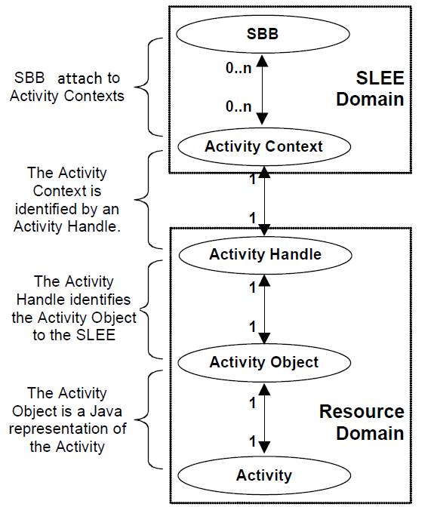
Activity /ActivityContext (cont.)
An Activity object resides within the resource domain.
An Activity Context resides in the SLEE domain to represent an underlying Activity object in the resource domain.

Slide 12
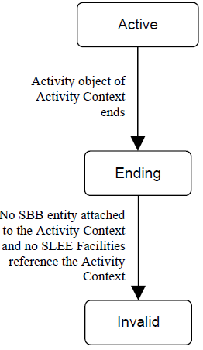
Activity /ActivityContext (cont.)
An ActivityContext can be in 3 states:
Active
Ending
Invalid
The lifecycle state of an ActivityContext is transactional.

Slide 13
Basic Concepts
Events

Slide 14
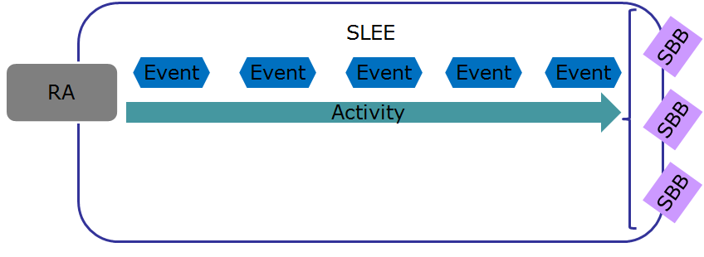
Events
Events represents some occurence of significants.
Events originate from a number of places: external places, SLEE, other services
SLEE services are triggered by events and process events
Events are Deployable Units, having: name, vendor, version.
The act of passing an event from its source to its destination is termed "Event Routing" in JSLEE.

Slide 15
Basic Concepts
Services

Slide 16
Services
Service is a deployment artifact defined by a Service 'deployment descriptor' that is deployed in the SLEE.
Service is a collection of one or more SBBs. One of the SBBs is the 'Root SBB'.
A service instance consists of one or more SBB instances of the type of SBB in the Service.
SBB instances in the same Service may process events concurrently.

Slide 17
Basic Concepts
SBB

Slide 18
SBB
SBB stands for Service Building Blocks.
An SBB component defines:
event types received and generated by the SBB component
Per-instance state is stored in CMP(Container Managed Persistent) fields that the SLEE manages
Event handler methods.
Local interface methods: defines the operations of the SBB component that may be invoked sync.
Child relations: an SBB component may be composed of 0 or more child SBB components.
Shareable state: SBB defines the state that it may share with the other components as a set of Activity Context properties.

Slide 19
SBB (cont.)
An SBB’s component identity uniquely identifies an SBB component: sbb-name + sbb-vendor + sbb-version
The SbbID class defines the interface of a Java object that encapsulates an SBB’s component identity.
The SBB local interface must extend the javax.slee.SbbLocalObject interface.
The SBB abstract class is mandatory and implements the javax.slee.Sbb interface.
SBB methods:
Event handler methods
Local interface methods
Life cycle callback methods
An sbbExceptionThrown callback method
An sbbRolledBack callback method
Initial event selector methods

Slide 20
SBB (cont.)
An SBB object is an instance of the SLEE generated class that extends the SBB abstract class
The SLEE creates and manages a pool of SBB objects.
It can receive and fire events, receive synchronous method invocations, and access and update the persistent state of the SBB entity.
SBB interfaces and classes naming convention:
SBB abstract class → <name>Sbb
SBB Activity Context Interface interface → <name>SbbActivityContextInterface
SBB local interface → <name>SbbLocalObject

Slide 21
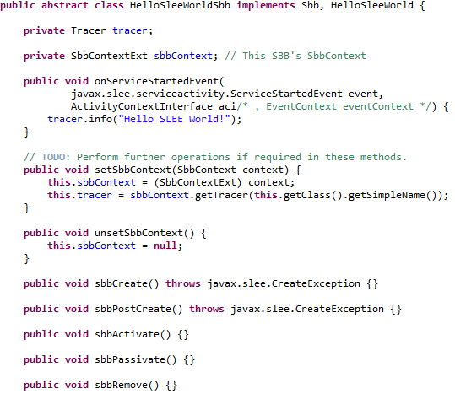
SBB (cont.)
The HelloSleeWorldSbb implements the javax.slee.Sbb inteface.

Slide 22
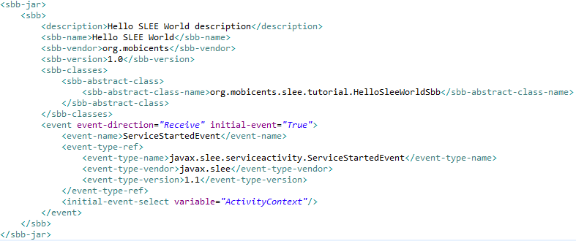
SBB (cont.)
The SBB definition is needed for SLEE vendor application server.
It contains the abstract SBB class and the events that the SBB is interested in.

Slide 23
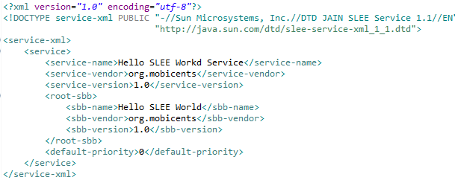
SBB (cont.)
The deployable unit contains the service xml file that contains the metadata.

Slide 24
Basic Concepts
Deployable Unit

Slide 25
Deployable unit
A deployable unit is a Jar file that can be installed in the SLEE.
A deployable unit may contain Services, SBB jar files, event jar files, Profile Specification jar files, resource adaptor type jar files, resource adaptor jar files, and library jar files.
Each of these jar files contain the Java class files and the deployment descriptors of one or more of these components.

Slide 26
Basic Concepts
Profiles

Slide 27
Profiles
Provisioned data required by the SBB to perform its function. E.g. configuration data or per subscriber data.
For each Profile Specification, the Profile Specification Developer provides the following parts:
A profile CMP interface
An optional Profile Local Interface
The Profile Specification Developer may provide an optional Profile Local interface.
This interface declares the methods that should be visible to SLEE Components such as SBBs, Resource Adaptors, or other Profile Specifications.

Slide 28
Basic Concepts
Usage Parameters

Slide 29
Usage Parameters
A usage parameter is a parameter that can be updated by an object in the SLEE to provide usage infomation.
It is accessible by the Administrator through the management interface of the SLEE.
Each usage parameter is addressed by a hierarchically scoped name:
Notification source name component: identifies the SLEE entity such as an SBB, Profile Table or RA entity.
Usage parameter set name component: identifies a usage parameter set accssible by the notification source.
Usage parameter name component: is the lowest-level scoped name and identifies a usage parameter by the notification source name component.

Slide 30
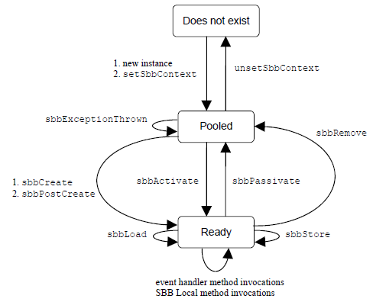
SBB Lifecycle
Does Not Exist state
The SBB object does not exist. It may not have been created or it may have been deleted.
Pooled state
The SBB object exists but is not assigned to any particular SBB entity.
Ready state
The SBB object in the Ready state is assigned to an SBB entity. It is ready to receive events

Slide 31
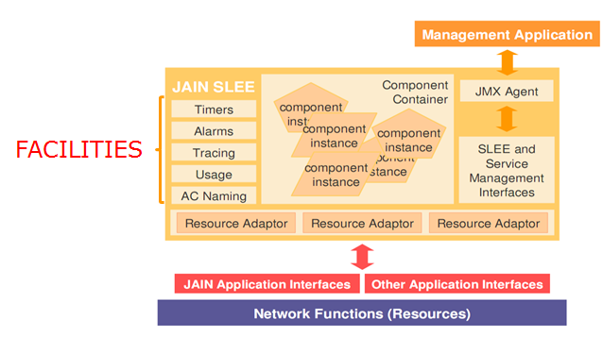
Facilities
Facilities are standard functional components provided by the SLEE

Slide 32
Facilities (cont.)
The SLEE specification defines the following standard Facilities:
Timer Facility
for initiating periodic actions
Alarm Facility
Used by SBBs, RA, Profiles to request the SLEE to raise or clear alarms.
Trace Facility
Generates trace messages intended for consumtion by external management clients.
Activity Context Naming Facility
Provides a global flat namespace for naming Activity Contexts
Profile Facility
Allows SBBs to obtain the ProfileTable object or ProfileTableActivity object for a specified ProfileTable.
Event Lookup Facility
Used by RA to obtain information about the event types installed in the SLEE.
Service Lookup Facility
Used by RA to obtain information about the types of events a Service installed in the SLEE may receive.

Slide 33
Management
The SLEE specification provides management capabilities for deployable units, Services, Resource Adaptors, Profile Tables, Profiles, the Alarm Facility, and the Trace Facility.
A management client manages the SLEE by interacting with a set of SLEE specification defined MBean objects, as defined by the Java Management Extension (JMX) specification.
The SLEE Mbean interfaces are Mbeans interfaces defined by the SLEE specification; thise interfaces are defined in the javax.slee.management package.
Example Mbean interfaces: SleeManagementMBean, ServiceManagementMBean, ServiceUsageMBnea, AlarmMBean, TraceMBean, ResourceManagementMBean, ProfileTableUsageMBean,etc.

Slide 34
Management (cont.)
Requirements of any management client that accesses the SLEE Mbean objects:
Client may only reference a SLEE MBean object by its Object Name.
Client can only invoke a SLEE MBean object through a local or remote MBean Server.
There are two approaches to implementing a custom SLEE management client.
implement the client as a MLet MBean.
implement a SLEE management client using the JMX Remote API.
The requirements of a management client MLet MBean are:
it can be implemented as any type of MBean supported by the JMX 1.2.1 specification.
should implement the javax.management.MBeanRegistration interface.

Slide 35
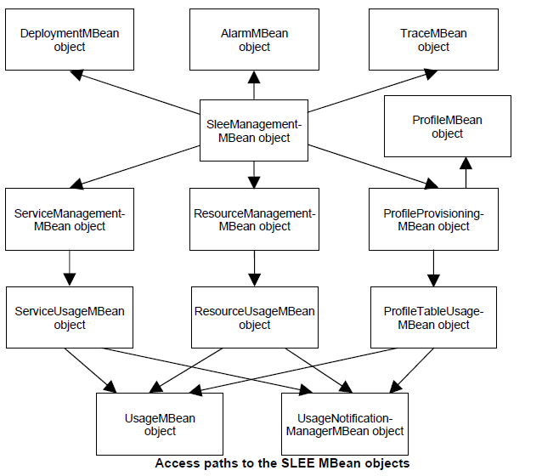
Management (cont.)
There are lots of MBean objects that provide the external management interface of the SLEE.

Slide 36
Resource Adaptor
Resources are entities that represent and interact with other systems outside the SLEE, such as network devices, protocol stacks,databases, directories, etc.
Resource adaptors adapt particular resources to the requirements of the SLEE.
Resource adaptor receives messages from external sources and submits them as events to the SLEE.
The SLEE Resource Adaptor architecture consists of APIs which are implemented by the SLEE:
Resource adaptor type
Defines the API and a contract that SBB use to interact with the Resource
Resource adaptor
Implementation of one or more resource adaptor types.
Resource adaptor entity
Represents the mapping within the SLEE of a particular resource as adapted by a RA.
Multiple resource adaptor entities may be created from a single RA.
Resource adaptor object
RA objects are Java objects that the SLEE uses to interact with RA entities.
SLEE Endpoint
Integrace used by a RA object to start Activities, fire Events on Activities and end Activities.

Slide 37
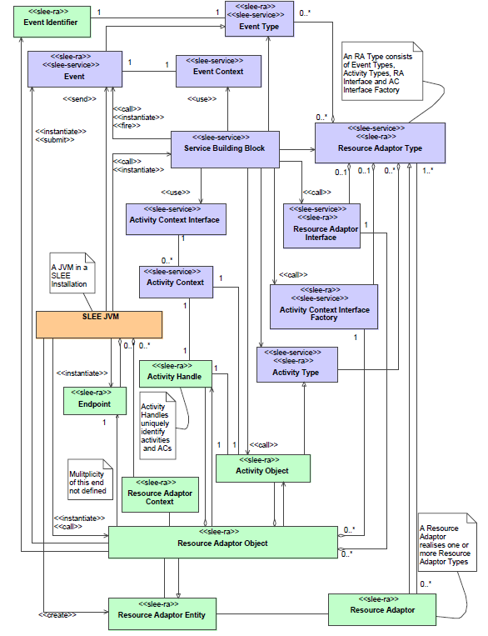
Resource Adaptor (cont.)
← Meta model of the Resource Adaptor architecture

Slide 38
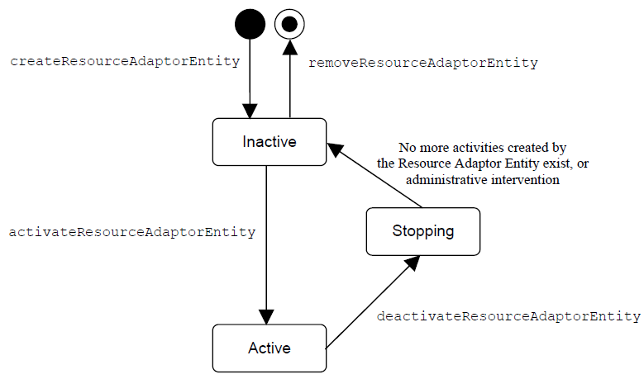
Resource Adaptor (cont.)
A resource adaptor entity can be in one the following 3 operational states:
Inactive
The RA entity is ready to be activated.
Active
The RA adaptor entity has been activated.
Stopping
The RA entity is being deactivated.

Slide 39
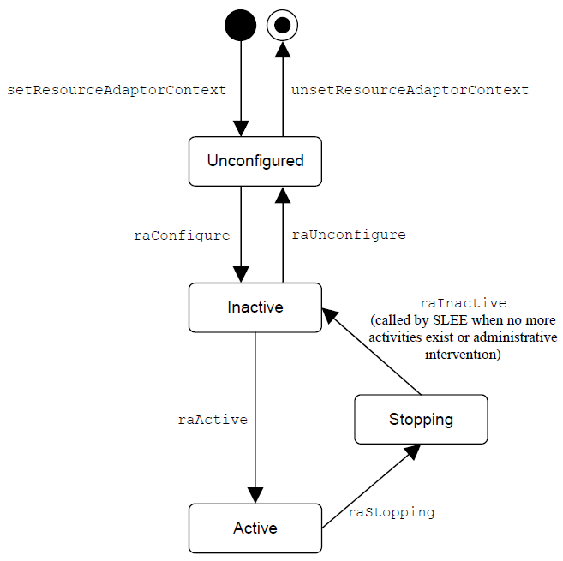
Resource Adaptor (cont.)
Resource adaptor class requirements:
RA class must be defined in a named package.
class must implement javax.slee.resource.ResourceAdaptor interface
class must be defined as public and cannot be abstract or final.
class must have a public no-argument constructor
Resource adaptor object lifecycle:
Unconfigured state
Inactive state
Active state
Stopping state

Slide 40
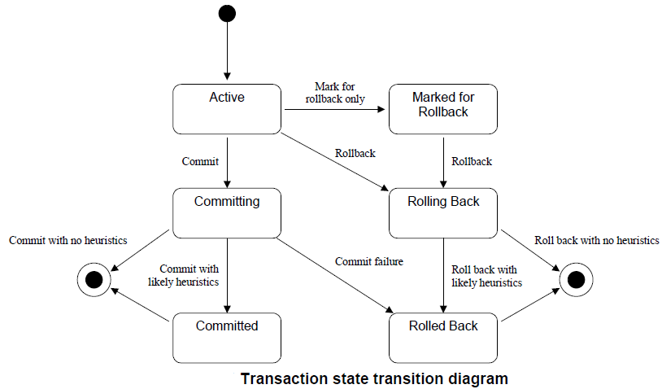
Transactions
All SLEEs must implement the transactional semantics defined in this specification.
All transactions are isolated from each other at the serializable isolation level.
The SLEE starts a transaction prior to a SLEE originated invocation sequence.
A resource adaptor object may also start and commit or rollback transactions for its own use.

Slide 41
Transactions
A transaction may be in one of the following states:
Active:
Transaction is typically created and initialized prior to the SLEE originated invocation sequence.
Committing
On successful completion of SLEE originated invocation sequence the transaction transitions from Active to Committing state.
Committed
Transition enters in this state when a heuristic has likely been applied.
Marked for Rollback
Extension of the transaction life cycle provided by the SLEE.
Rolling Back
A transaction in this state is in the process of rolling back.
Rolled Back
Tra.nsaction has been aborted

Slide 42
SLEE Vendors
There are 2 SLEE vendors:
Mobicents
Rhino from OpenCloud
Mobicents is an Open Source VoIP Platform written in Java to help create, deploy, manage services and applications integrating voice, video and data across a range of IP and legacy communications networks.
OpenCloud Rhino Telecom Application Server is the world-leading converged carrier-grade Telecom Application Server (TAS).
Rhino Telecoms Application Server complies with both Java telecom application server standards – JAIN SLEE (JSLEE) and SIP Servlet.

Slide 43
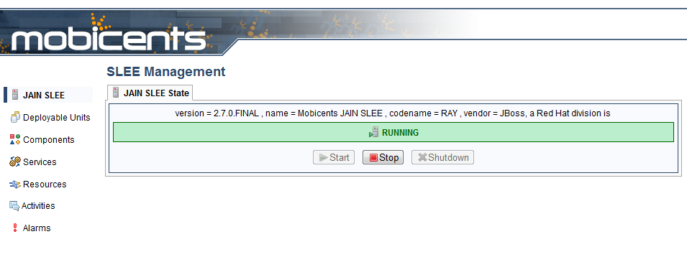
Mobicents SLEE
Mobicents can be installed on Tomcat or Jboss.
The Mobicents managements can be found at http://localhost:8080/slee-management-console.

Slide 44
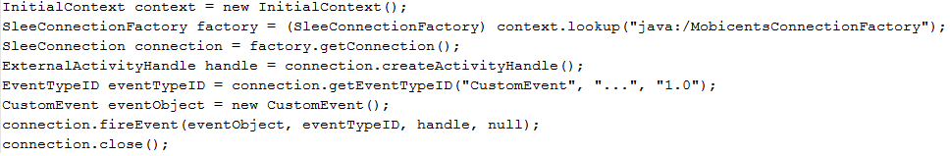
Mobicents SLEE (cont.)
The JAIN SLEE specification includes an API for interaction with JAIN SLEE container.
External applications can connect via interface javax.slee.connection.SleeConnectionFactory and fire events.
JAIN SLEE provides two different implementations of the API, one for access in the same JVM, another for remote access.

Slide 45
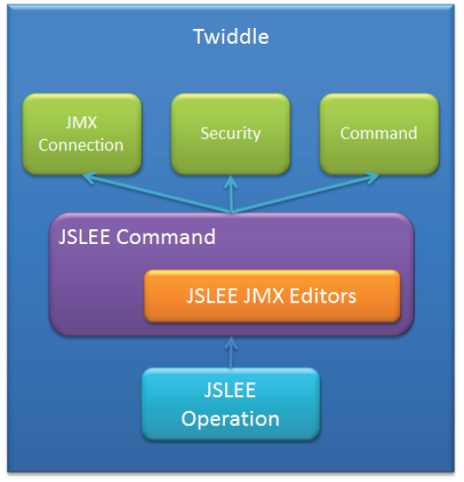
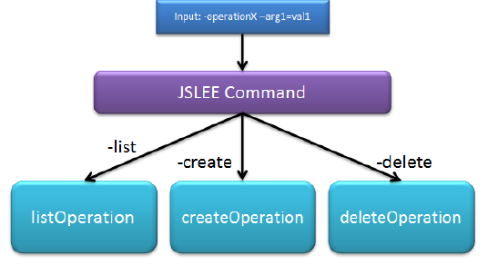
Mobicents SLEE (cont.)
Mobicents JSLEE Twiddle is command line tool, based on JBoss JMX.
Mobicents JSLEE Twiddle acts on base of command and operation.
Command supports various operations.
Operation is aware of specific resource that needs to be called and how it should be accessed to perform certain task.

Slide 46
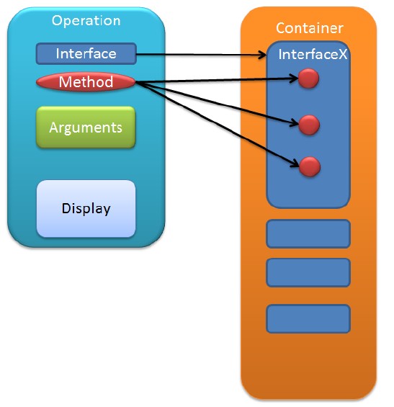
Mobicents SLEE (cont.)
twiddle.sh [options] <command> [command_arguments]
slee command interacts with javax.slee.management:name=SleeManagement

Slide 47
Mobicents
Diameter Base RA

Slide 48
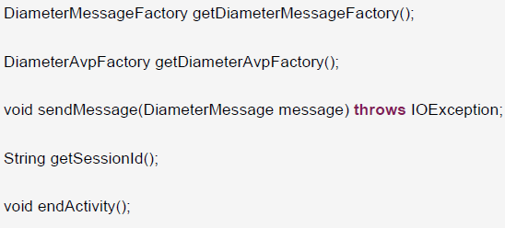
Diameter Base RA
Diameter Base Resource Adaptor Type is defined by Mobicents team as part of effort to standardize RA Types.
Diameter Base Type defines the following Activities:
AuthClientSessionActivity: client side of Base Authentication session. Abort-Session-Request (ASR) and Re-Auth-Request (RAR) messages are received in this Activity
AuthServerSessionActivity: represents server side of Base Authentication session.
AccountingClientSessionActivity: represents client side of Base Accounting session. Accounting-Request (ACR) messages can be created and sent in this Activity.
AccountingServerSessionActivity: represents server side of Base Accounting session. Accounting-Request(ACR) messages are received in this Activity.
DiameterActvity: represents a generic Diameter session

Slide 49
Diameter Base RA (cont.)
Events received on Authorization Client Activity : SessionTerminationRequest, AbortSessionAnswer, ReAuthAnswer, ErrorAnswer, AbortSessionRequest, SessionTerminationAnswer, ReAuthRequest, ErrorAnswer.
Events received on Accounting Server Activity: AccountingRequest
Events received on Accounting Client Activity: AccountingAnswer, ErrorAnswer.
Events received on Generic Diameter Activity: ExtensionDiameterMessage, ErrorAnswer, CapabilitiesExchangeRequest, CapabilitiesExchangeAnswer, DeviceWatchdogRequest, DeviceWatchdogAnswer, DisconnectPeerRequest, DisconnectPeerAnswer.
The Mobicents Diameter Base Resource Adaptor SBB Interface provides SBBs with access to the Diameter objects required for creating and sending messages using the interface DiameterProvider.

Slide 50
Conclusions
JAIN SLEE is used in the telephony.
For telephony, data and wireless communications networks the API brings:
Service portability
Network independe
Open development
SLEE can be used to interface with other application servers and services.

Slide 51

Bibliography
JAIN SLEE (JSLEE) 1.1 Specification, Final Release
Mobicents User Guide

